Slide 1

Real Estate Data Analysis
Melissa Djohan
Limei Hou
Indira Poovambur

Slide 2
Core Message/Hypothesis:
Times are changing — and at a much faster pace than ever have before.
PyConstruction Inc., a burgeoning construction company based out of New York is specializing in building "live work and play" communities. In their most recent efforts,
they've started tackling first part of the paradigm "live" by compiling real estate data from cities to find out what Americans like the most when it comes to living
and how much are they willing to pay.
Our objective is to analyze the data and assist PyConstruction Inc. in coming up with a good plan.
We wanted to find out if our randomly picked three cities would have any sort of correlation.
The main question we wanted to answer is:
Is there a significant difference in average yearly market value between the three cities, using significance level α = 0.05?

Slide 3
H_{o}: H_{A}:

Slide 4
Other questions we wanted to answer in the process:
What are other factors that go into the market value of a home?
Room count?
Bedroom count?
Bathroom count?

Slide 5


Slide 6
Data Exploration and Clean-up Process:
Dropped the data frame from 124 to 12 columns
Renamed columns to more meaningful names
In some cases sorted the columns
In some cases converted the data type to facilitate sorting of the column

Slide 7
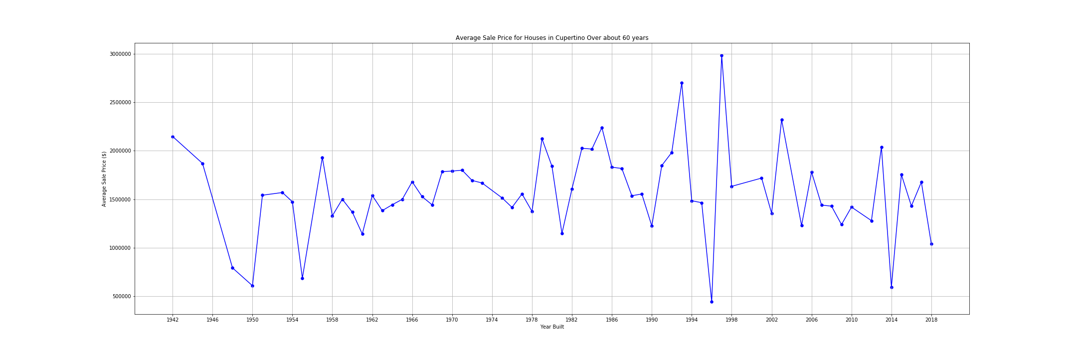
Are the houses selling?
Cupertino
Avg price between 1 to 2 M, drop from their 3 M.

Slide 8
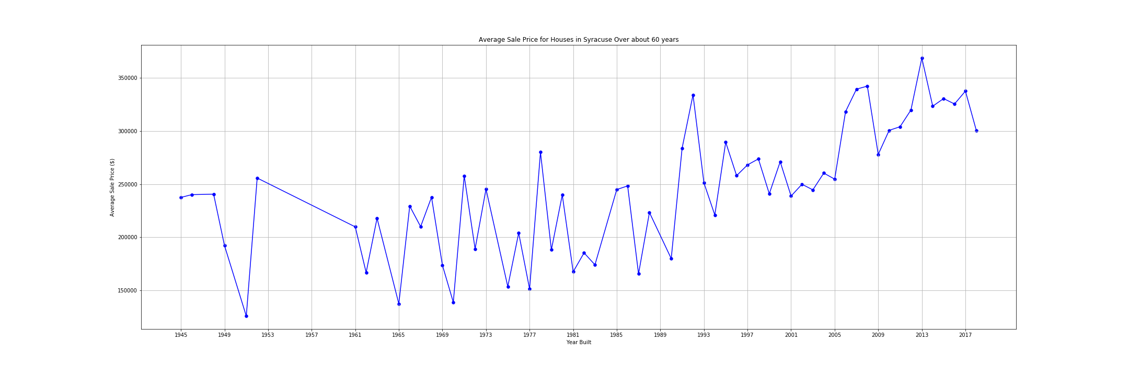
Syracuse
The market looks good here, the average price has gone up and is at a all time high.

Slide 9
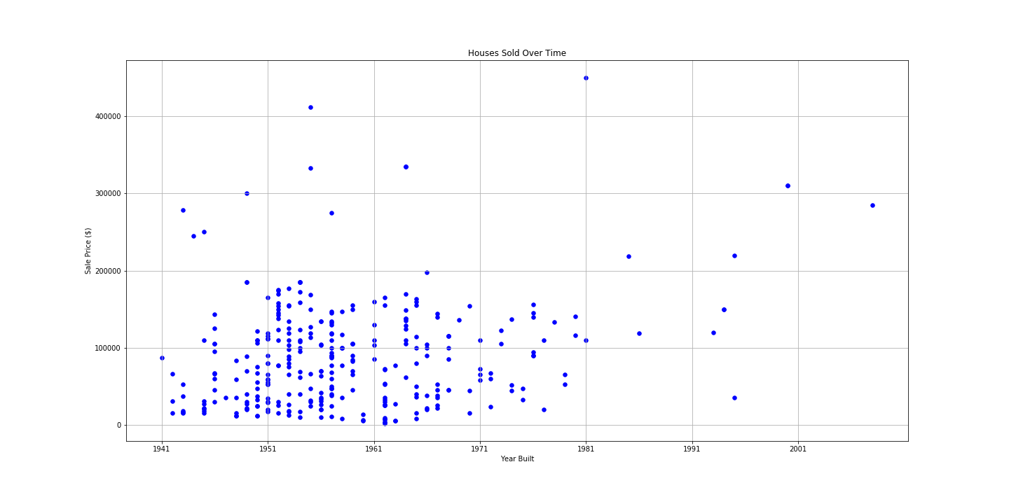
Chicago
Overall a bad housing market, so no further analysis conducted.

Slide 10
So… When it comes to house sales what sells more? Going by the three factors - Room Count, Bedroom count and bathroom count here are our findings: Cupertino : 8 rooms, 3 bedrooms, 2 baths What sold the most? Syracuse:6 rooms, 2 bedrooms, 2 baths. Note: In Syracuse they have three-quarter bath!! A three-quarter bathroom, sometimes simply called a three-quarter or 3/4 bath, is generally one with a toilet, sink and shower, but not a tub.
Cupertino: 8 rooms, 3 bedrooms,2 baths.

Slide 11
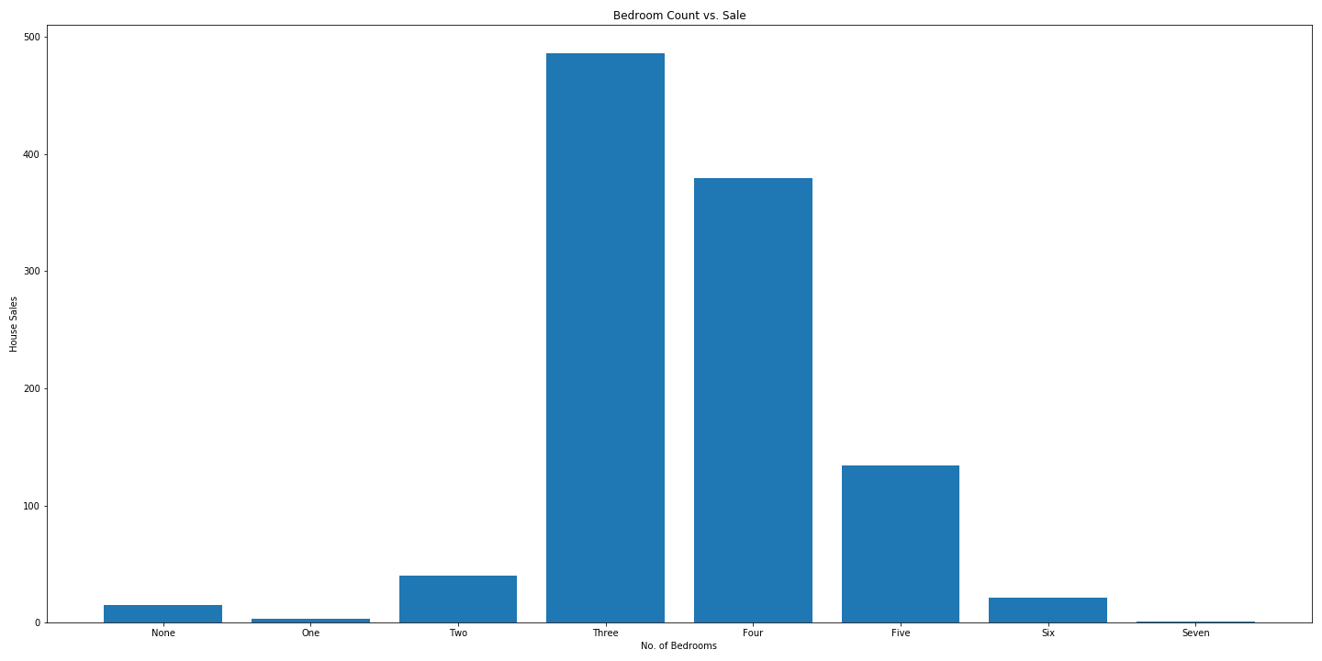
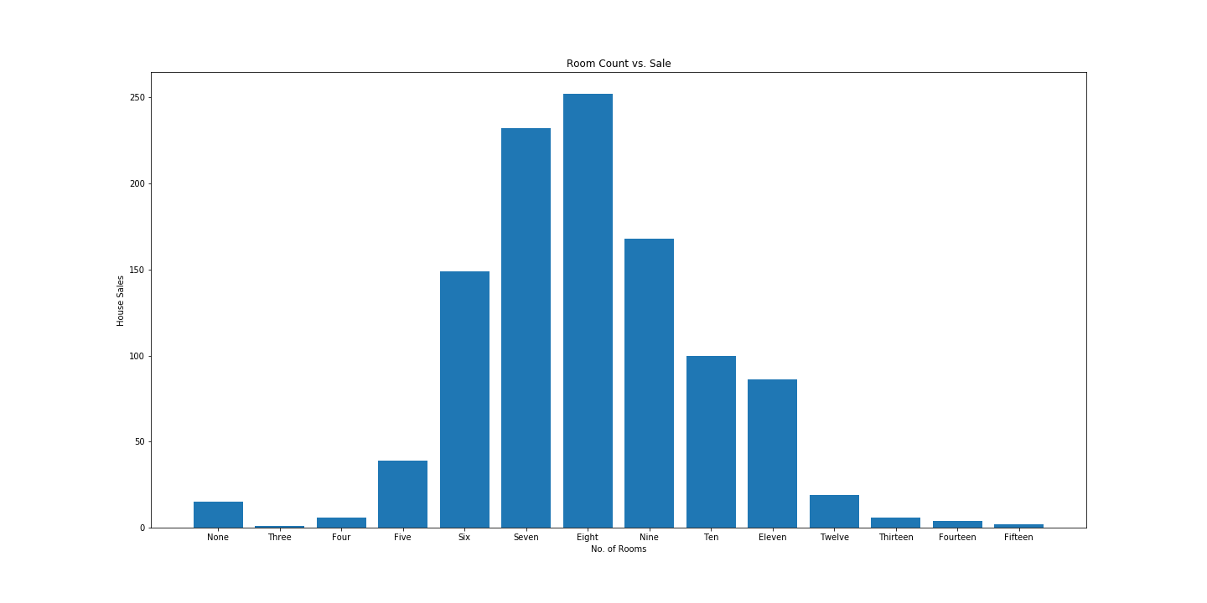
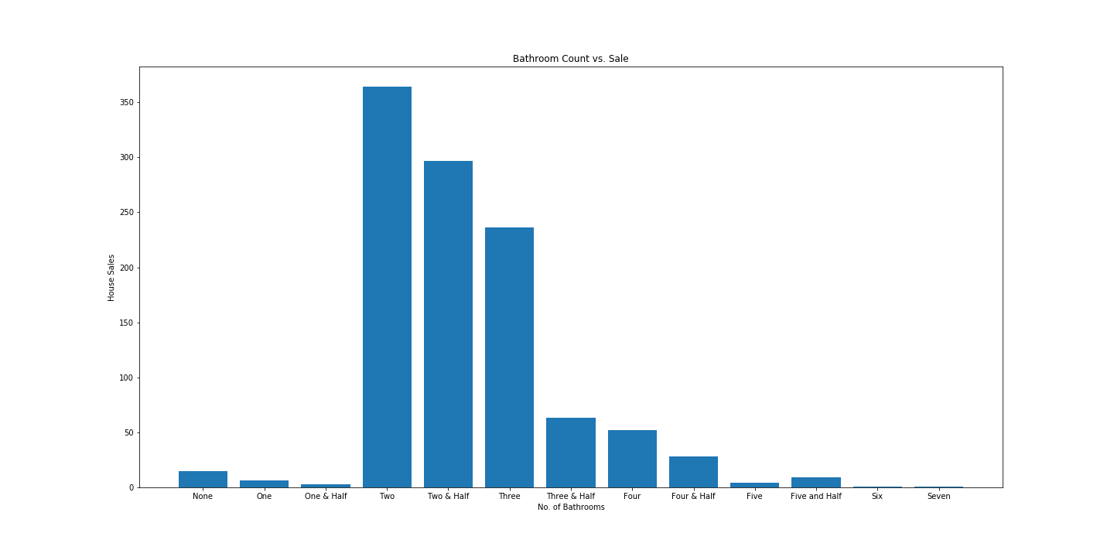
Cupertino

Slide 12
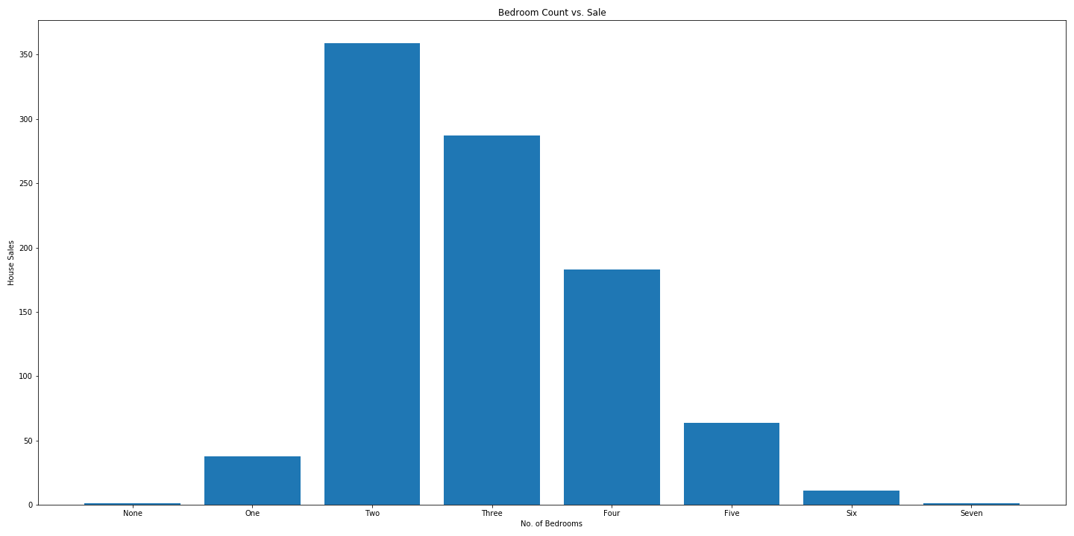
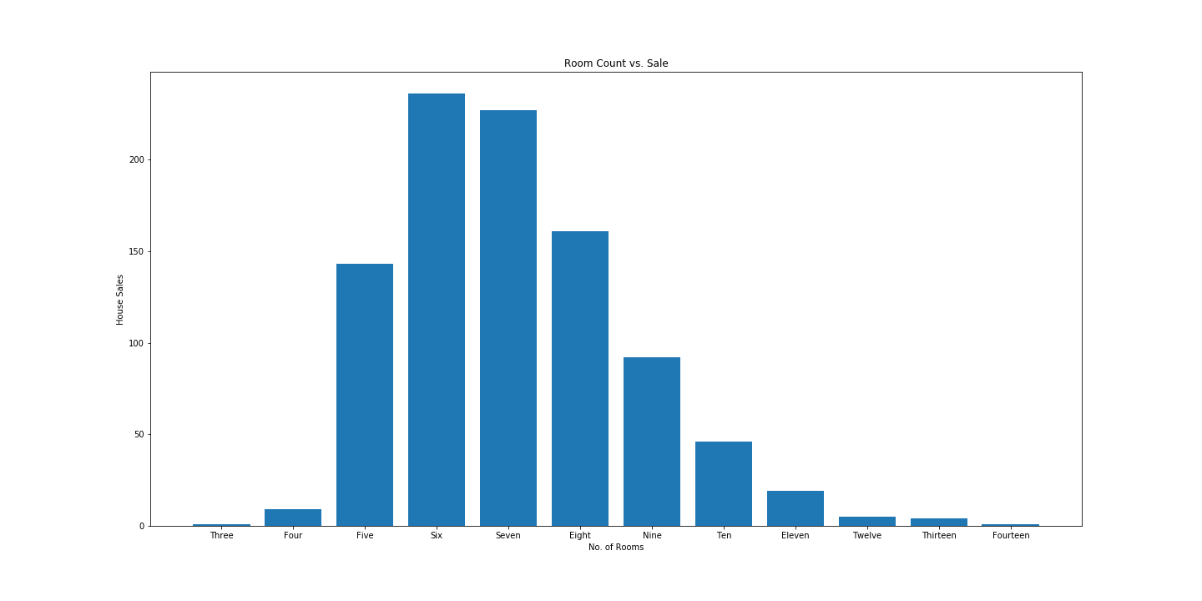
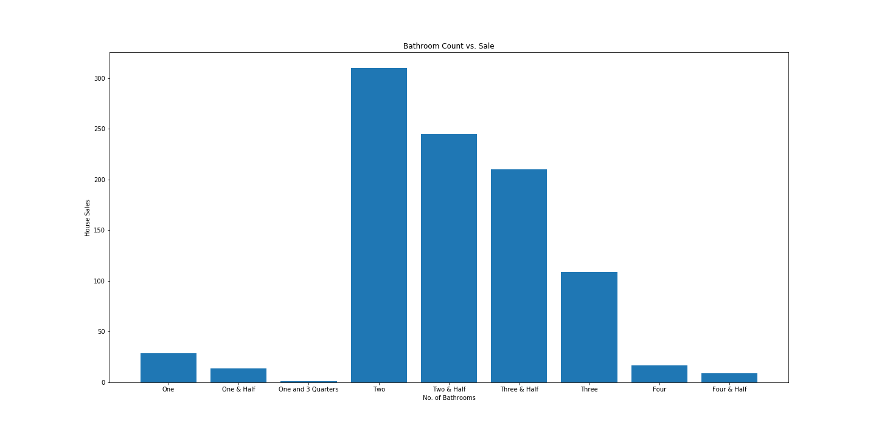
Syracuse

Slide 13
Summary: Syracuse is the top market. Mid size homes with 6-8 rooms, 2 baths and 3 bedrooms are the top performers Other factors like Parking and Lot size do not have a major impact on the sale. So..America is fairly ready for live work and play community.

